Slide 1
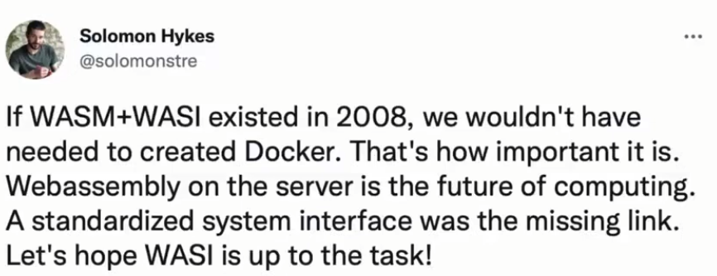

Slide 2
1 The Evolution of Virtualization Technology
2 The Container Runtime Structure
3 Webassembly Overview
4 Wasm: quo and future
Agenda

Slide 3
1 The Evolution of Virtualization Technology

Slide 4
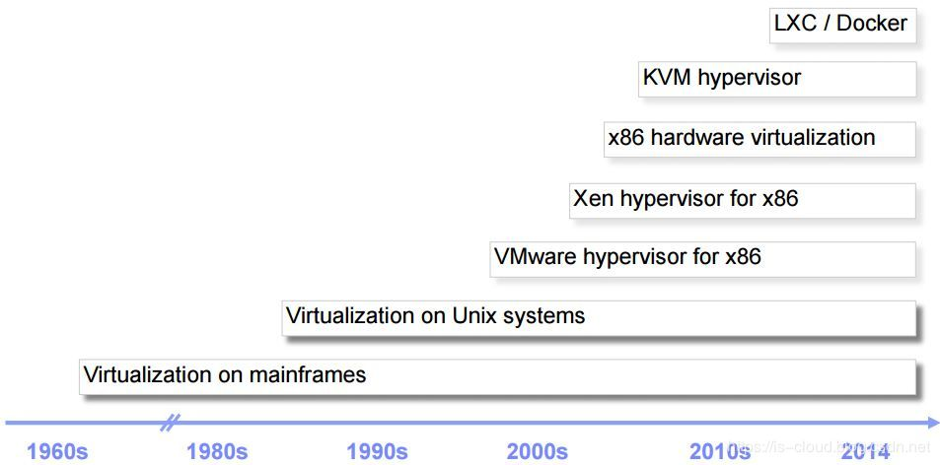

Slide 5
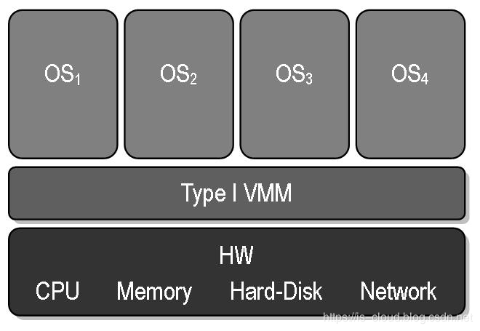
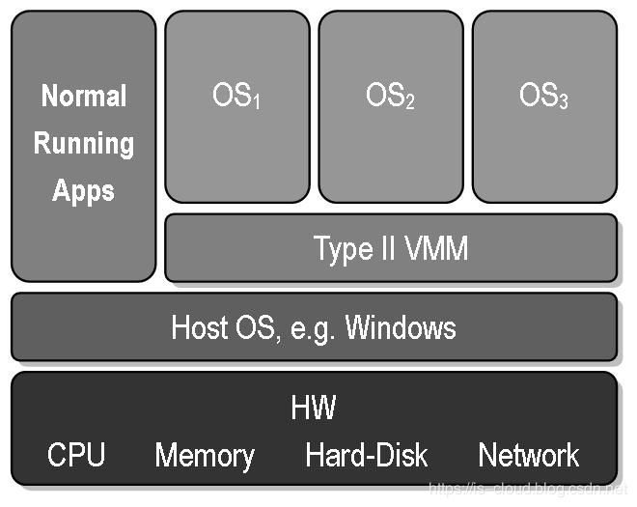
HyperVisor Type
1 Based on HW: VMWare esxi, OpenStack
2 Based on HostOS: VMWare Workstation, Virtualbox, Microsoft hyper-v

Slide 6
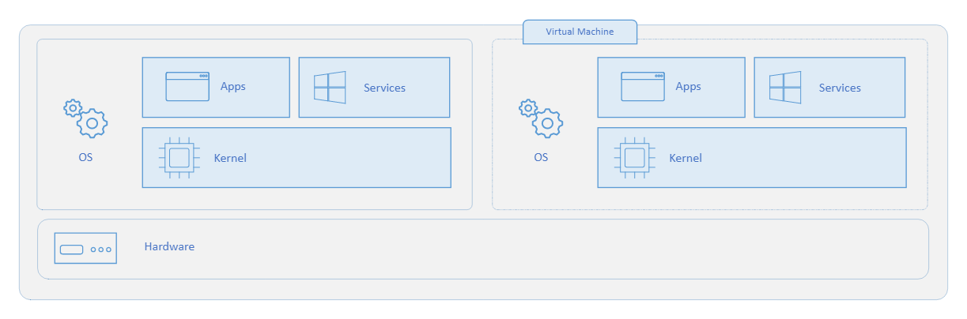
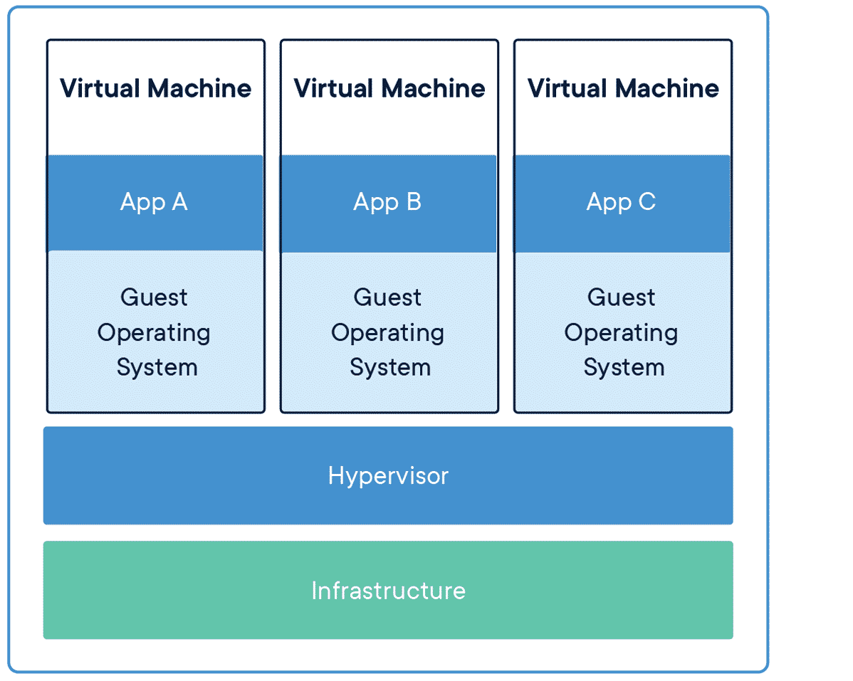
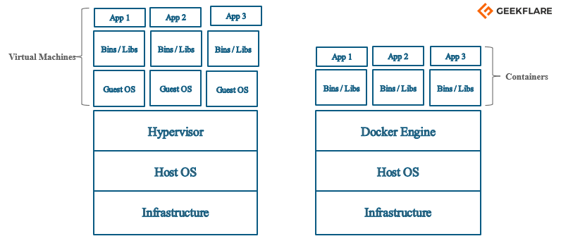
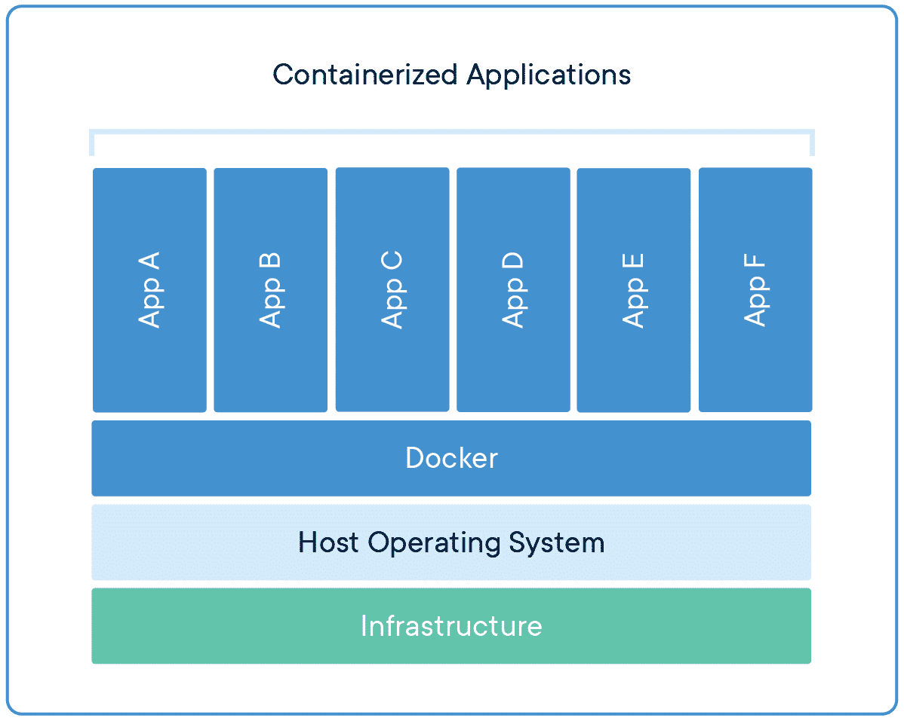
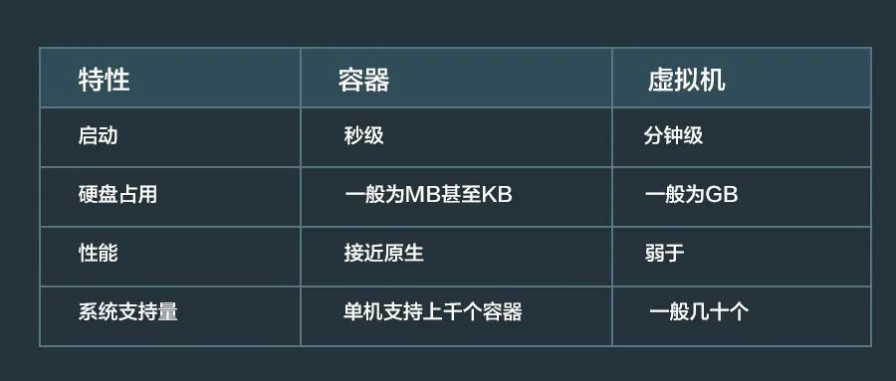
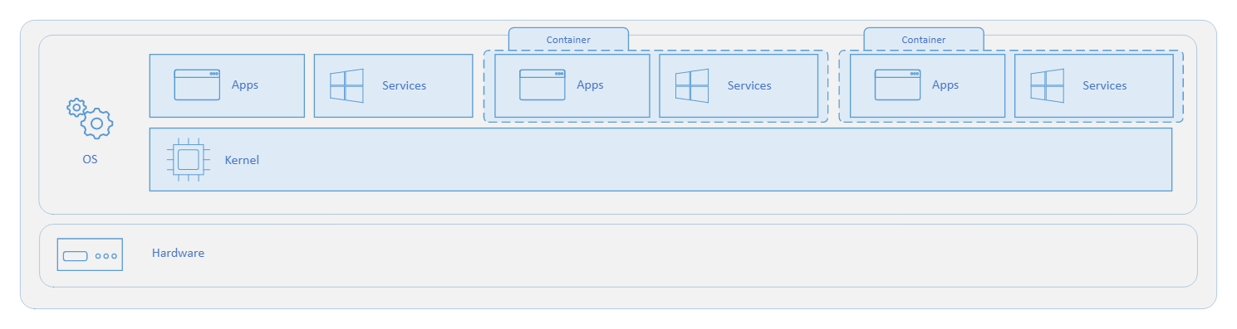
VM vs Docker (container)
No Guest OS in docker
You only have to know that
Containers only virtualize software layers above the OS level
Containers are relatively lightweight
Containers have Poor isolation

Slide 7
2 The Container Runtime Structure

Slide 8
Docker unit is container, k8s unit is pod
CRI and OCI is very important specification

Slide 9
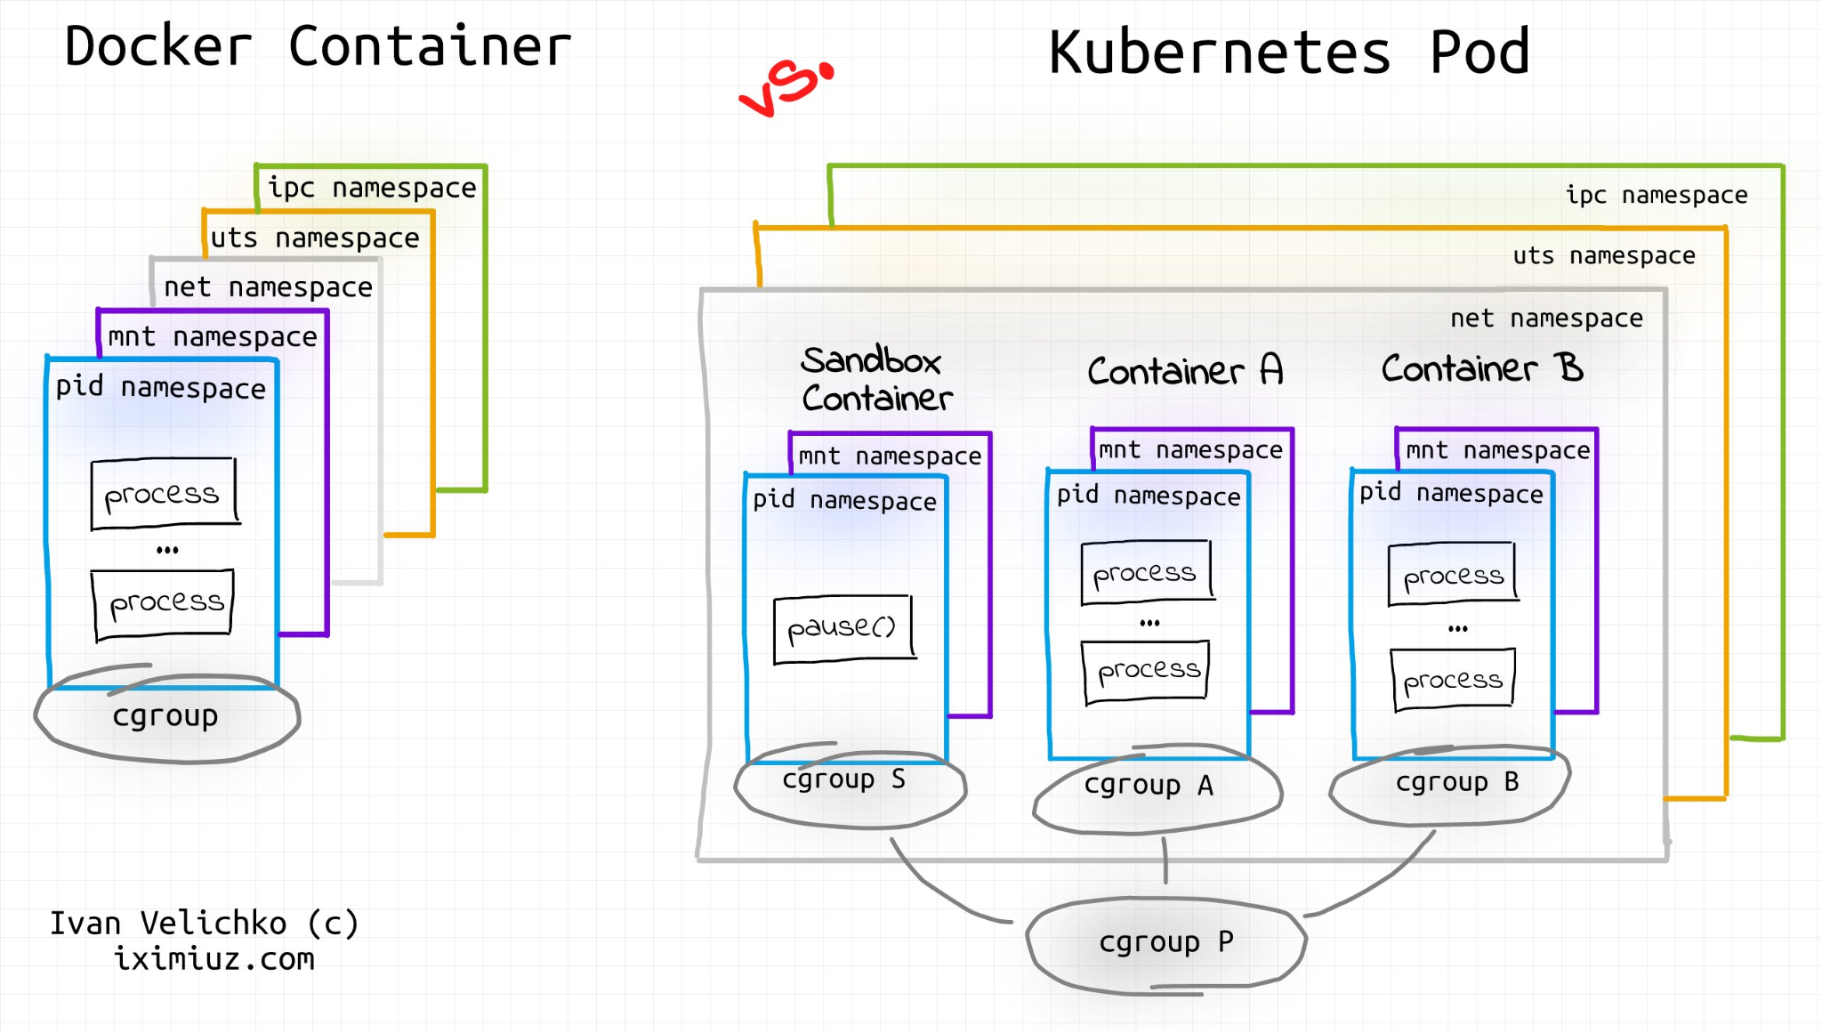

Slide 10
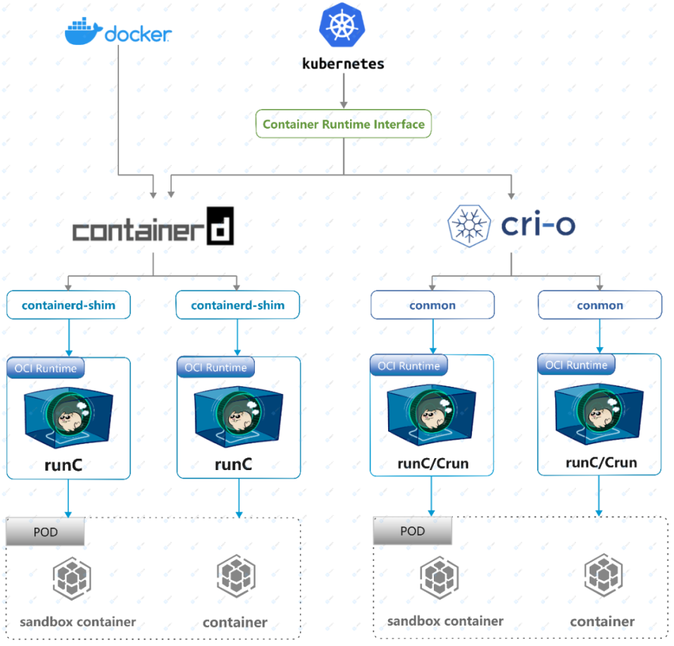
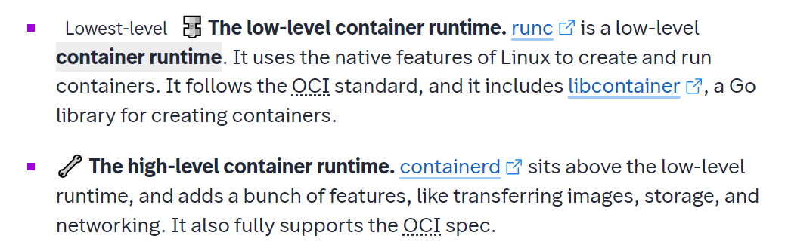
CRI (container runtime interface)
OCI(open container initiative)

Slide 11
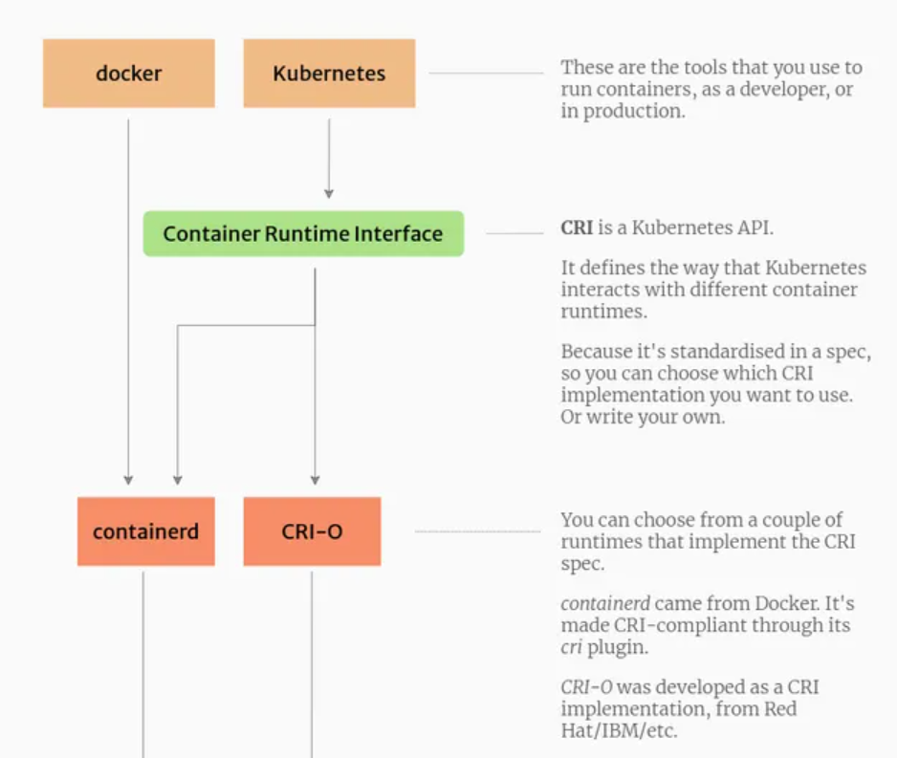
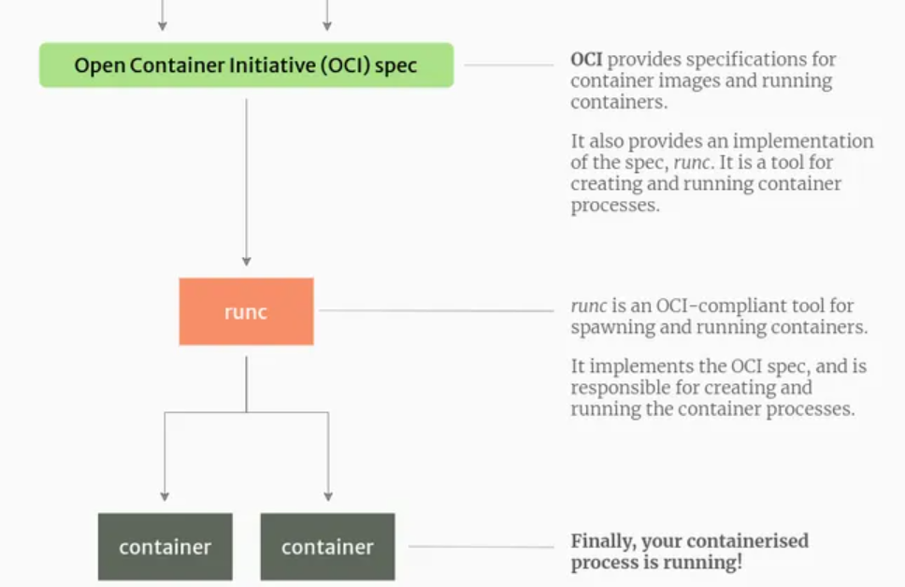

Slide 12
3 Webassembly Overview

Slide 13

A sad story for JVM
JVM is a light-weight VM. Ok, you know bro, it’s similar with container. XD
Use JVM instead of container to be managed by k8s !!
AOT > JIT
container
container
Native
jvm
Native >
>
java

Slide 14
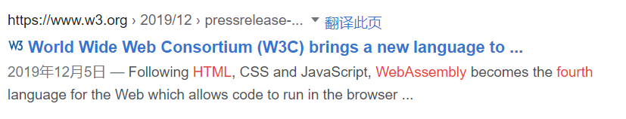
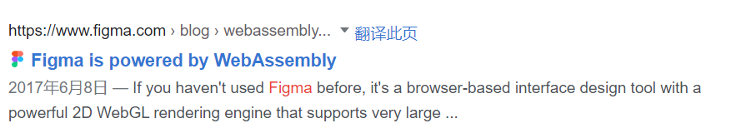
Webassembly (wasm)
Maybe you know wasm,
as the fourth language for the Web,
or when figma said they used it,
or a new said that you can run python, sqlite, even unity3d in web by wasm

Slide 15
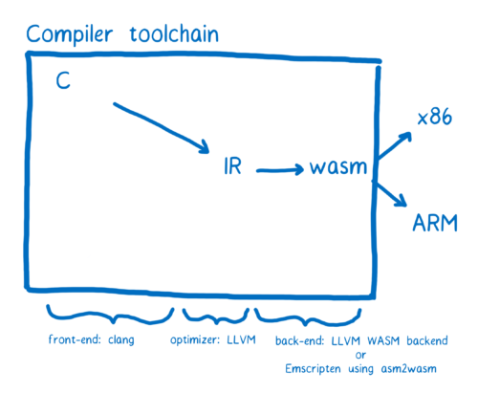
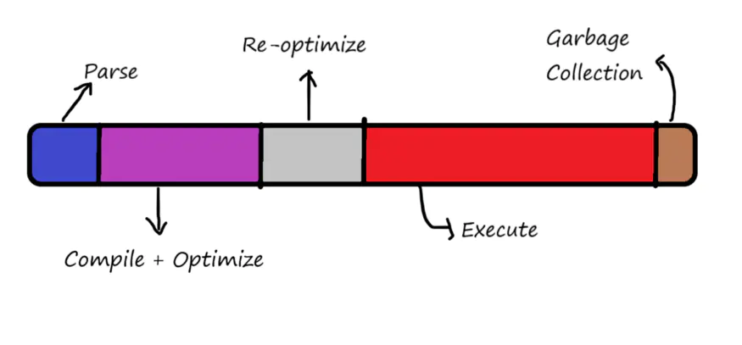
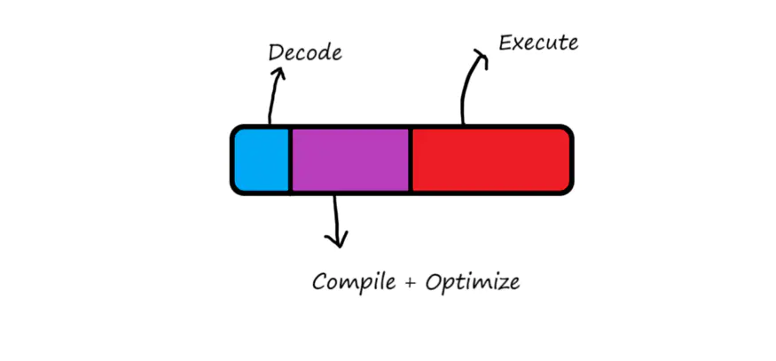
Webassembly (wasm)
There all belong to frontend, today, we focus on backend. Here wasm is sharper, stronger and infinitely imaginative !

Slide 16
Many language support wasm, because it’s a global specification, just like .class file specification.
Java,Scala,Kotlin
c,c++,rust,java,go,js….
.class
.wasm
jvm (java runtime)
wasm-runtime
Compare to jvm:
wasm supports streaming compilation - i.e. you can start compiling the code while downloading
simple validation rules compared to Java / JVM languages
isolation, secure, simple, minimising the overall attack surface
many languages

Slide 17
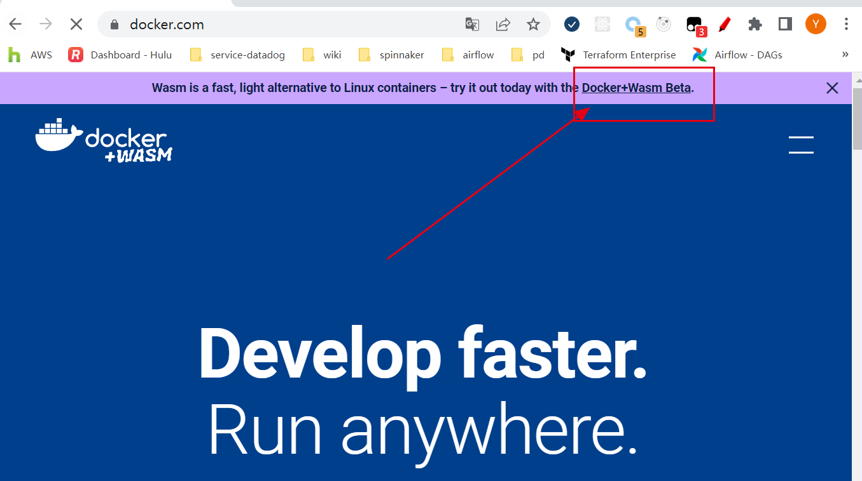
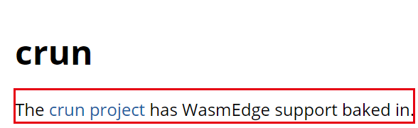
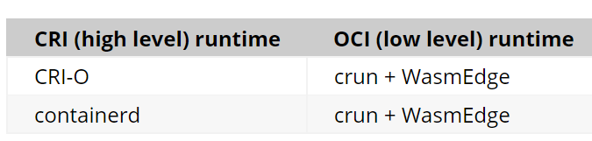
Wasm is being adopted by cloud native

Slide 18
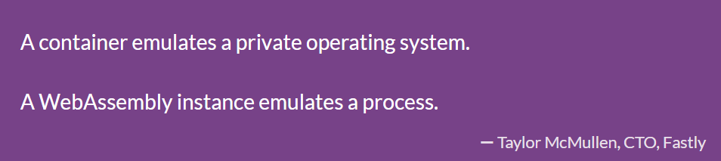
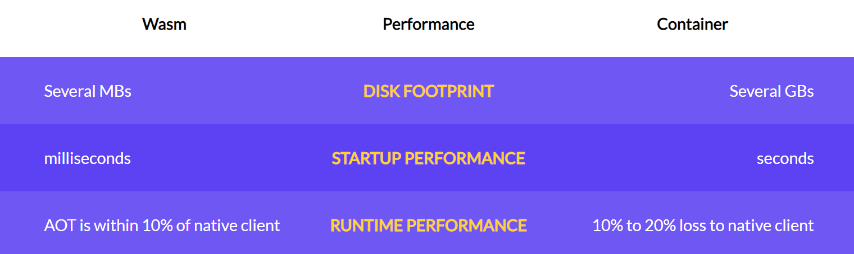
container vs wasm

Slide 19
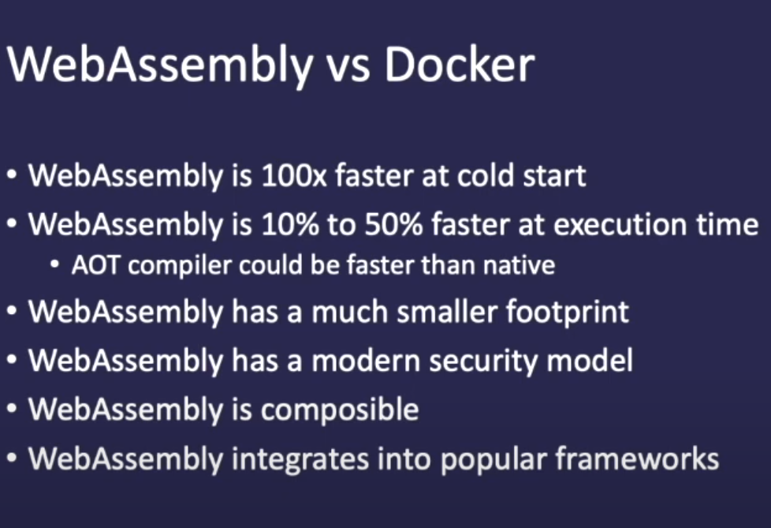

Slide 20
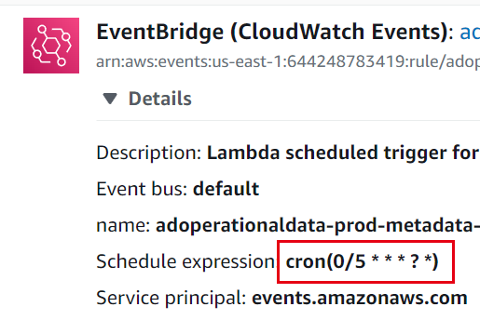
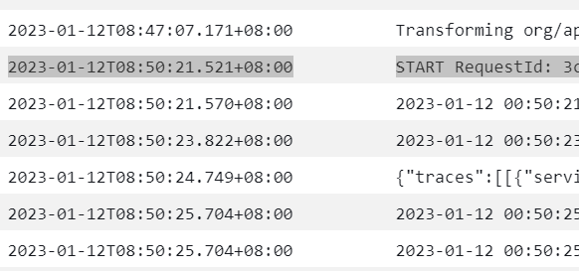
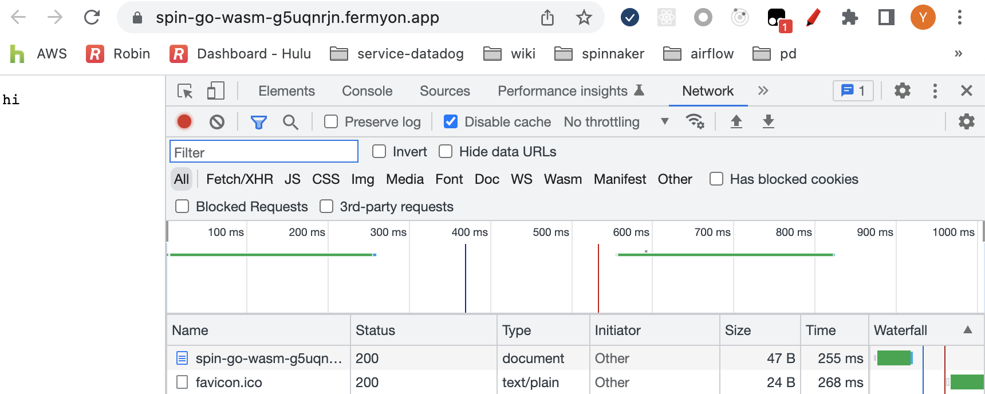
Start time
aws lambda (based on container or microVM)(21s)
spin (based on wasm-runtime, run the wasm file for each request)(255ms)

Slide 21
4 WASM: QUO and FUTURE

Slide 22
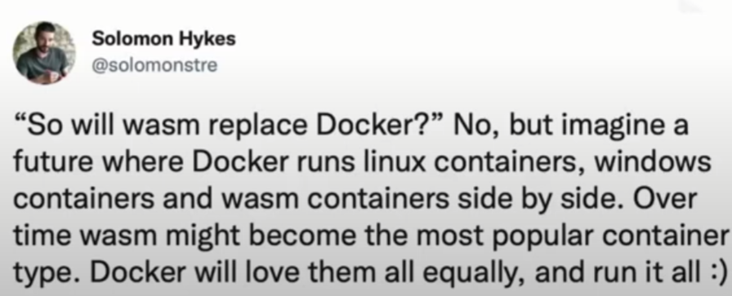
1 Docker + Wasm

Slide 23
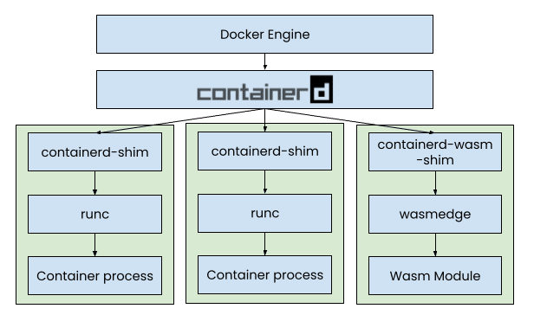
1 Docker + Wasm

Slide 24
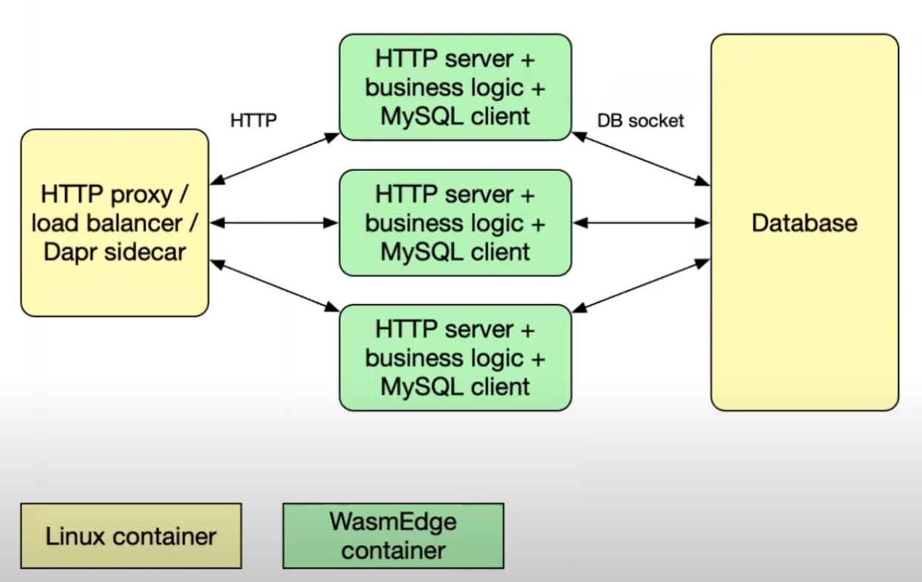
1 Docker + Wasm
git clone https://github.com/second-state/microservice-rust-mysql.git
docker compose up

Slide 25
1 Docker + Wasm
Show a simple demo

Slide 26

2 Faas + Wasm
What is Spin?
Spin is an open source framework for building and running fast, secure, and composable cloud microservices with WebAssembly. It aims to be the easiest way to get started with WebAssembly microservices, and takes advantage of the latest developments in the WebAssembly component model and Wasmtime runtime.

Slide 27
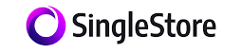
3 Paas + Wasm
Code Engine - Powered by Wasm
The Code Engine feature in SingleStoreDB supports creating functions (UDFs and TVFs) using code compiled to WebAssembly (Wasm). The Code Engine uses the wasmtime runtime to compile and run WebAssembly code. See Wasmtime for more information.

Slide 28
4 Future
Microservice
Isolation, edge cloud
Paas plugin (single-store udf)
WASI network interface not finish
Rust is too hard
AOT speed up

